Slide 1
2.1
4
F1:120
DATA: /GOLD60.CSV
1
F2: 56
N° X and Y: 12
2
Z: 4
3
X: X1, X2, X3…X12
Y: Y1, Y2, Y3… Y12
4
RUN
DATA: /GLOBAL1.CSV
5
X: X1, X2, X3…X12
Y: Y1, Y2, Y3… Y12
4
RUN
6
1
2
3
4
5
6
7
7
SAVE

Slide 2
SAVES
Save 1
LOAD
Save 2
LOAD

Slide 3
SAVES
F1:120
DATA: /GOLD60.CSV
F2: 56
N° X and Y: 12
THE RESULTS MUST SHOW THE EXACT RESULTS AND INFO OF THE SAVING (INCLOUDING THE 7 GRAPHS RESULTS)
Z: 4
X: X1, X2, X3…X12
Y: Y1, Y2, Y3… Y12
DATA: /GLOBAL1.CSV
X: X1, X2, X3…X12
Y: Y1, Y2, Y3… Y12
1
2
3
4
5
6
7

Slide 4
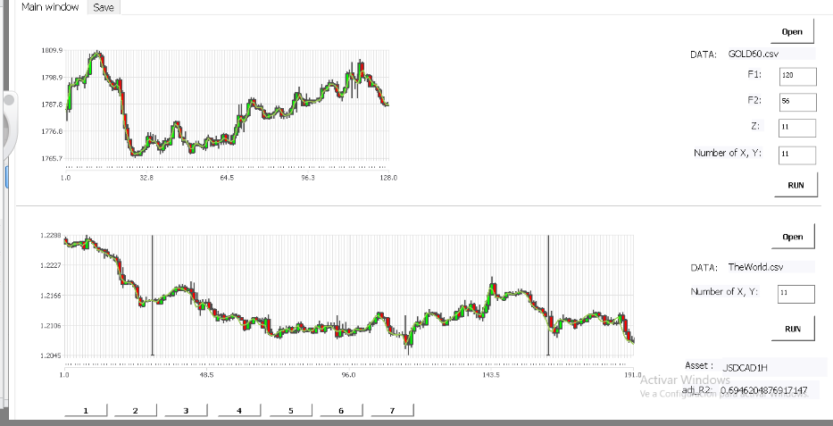
F1:120
A COMPARISON GRAPH WITH RED LINES OF ONLY THIS GRAPH, IT’S FROM THE XY NUMBERS (11 IN THIS CASE)
DATA: /GOLD60.CSV
F2: 56
N° X and Y: 12
Z: 4
X: X1, X2, X3…X12
Y: Y1, Y2, Y3… Y12
RUN
DATA: /GLOBAL1.CSV
X: X1, X2, X3…X12
Y: Y1, Y2, Y3… Y12
RUN
1
2
3
4
5
6
7
SAVE

